Slide 1
FEATURES

Slide 2
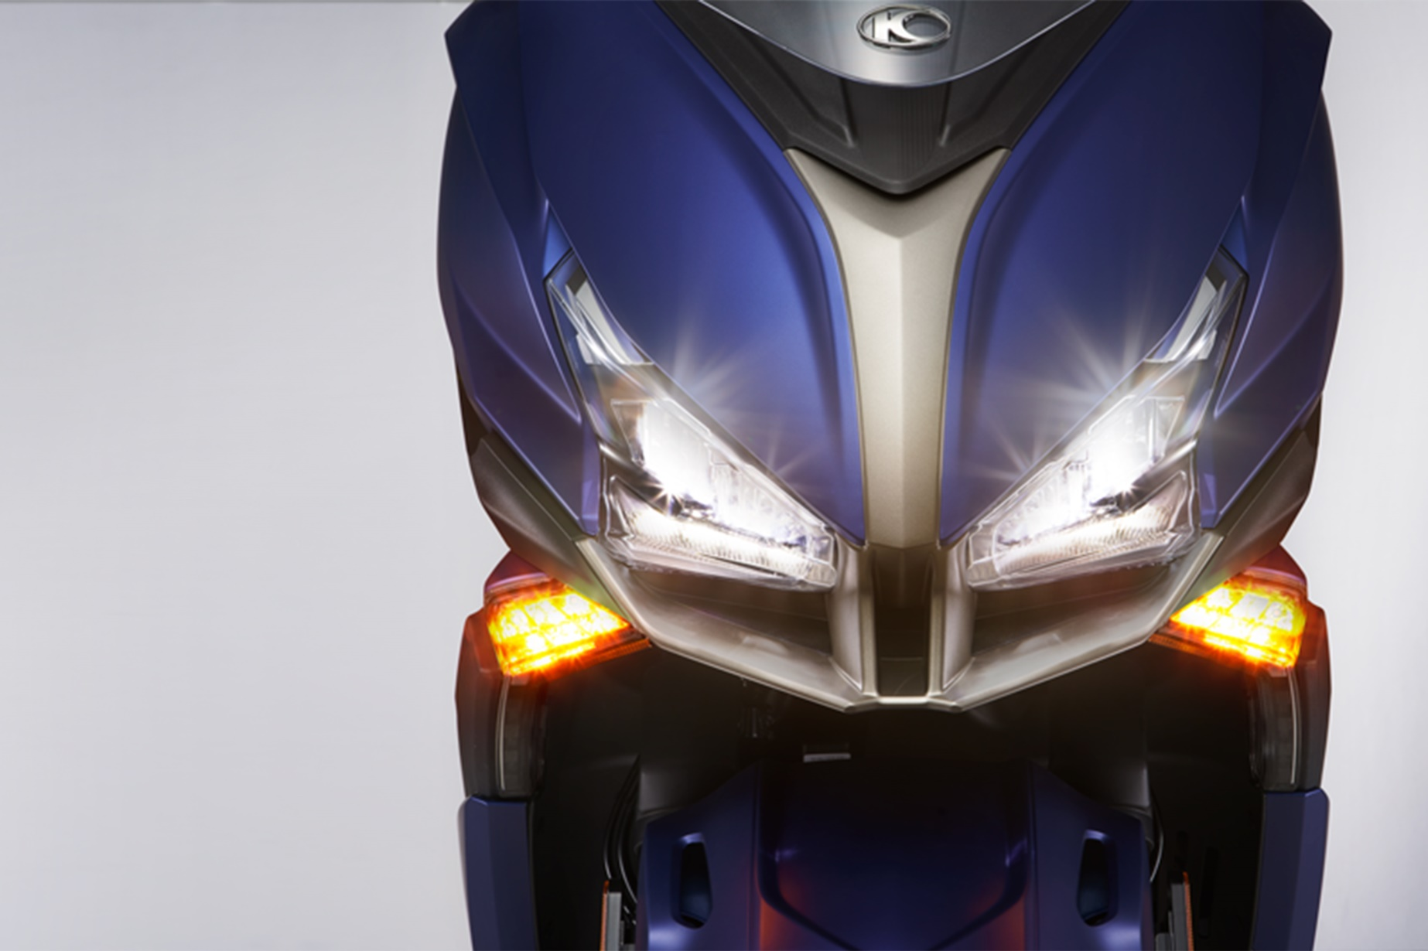
LED Headlight (Daytime Running Light)

Slide 3
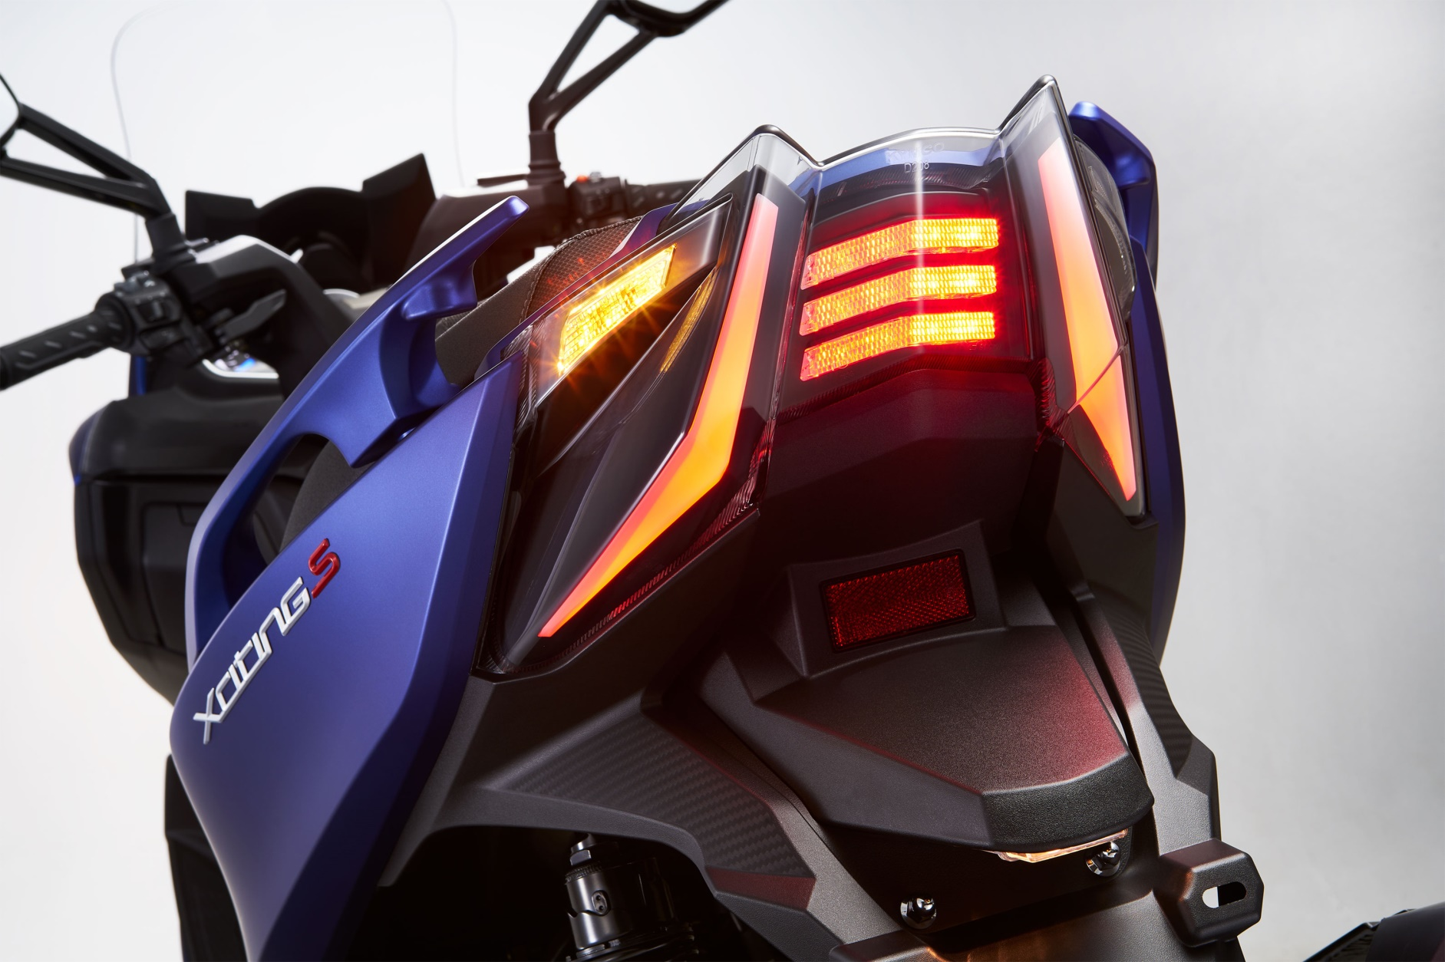
LED Tail Light (Highly Visible LED Strip)

Slide 4
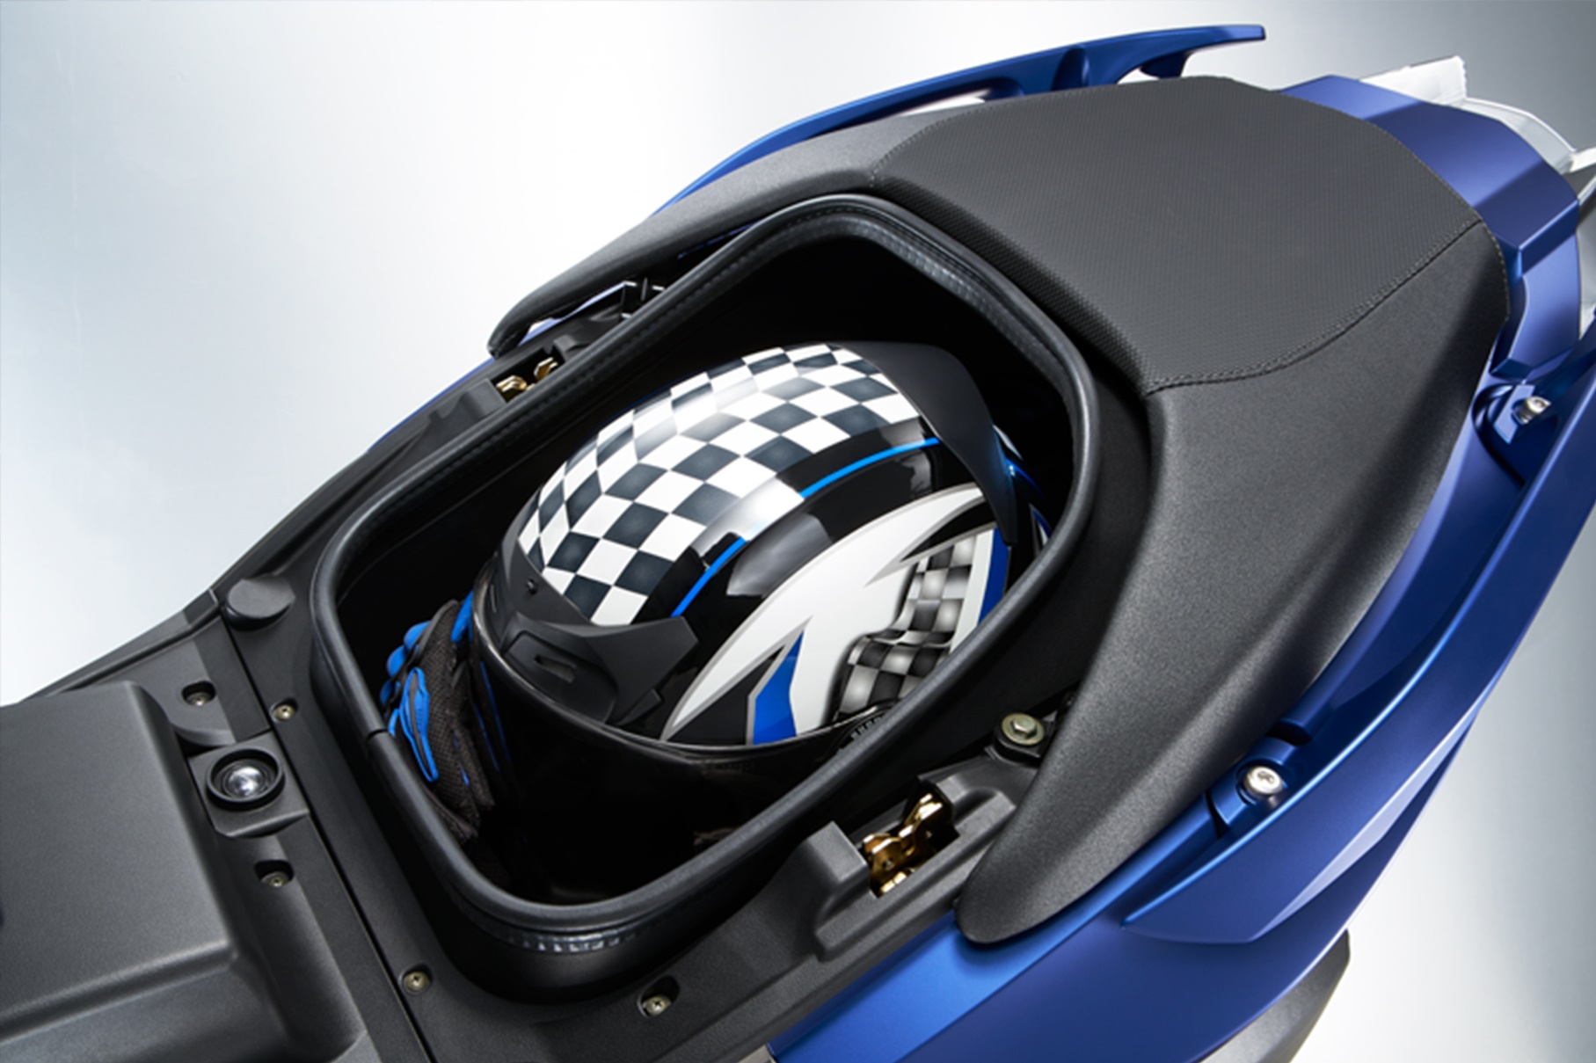
Independent Front Seat

Slide 5
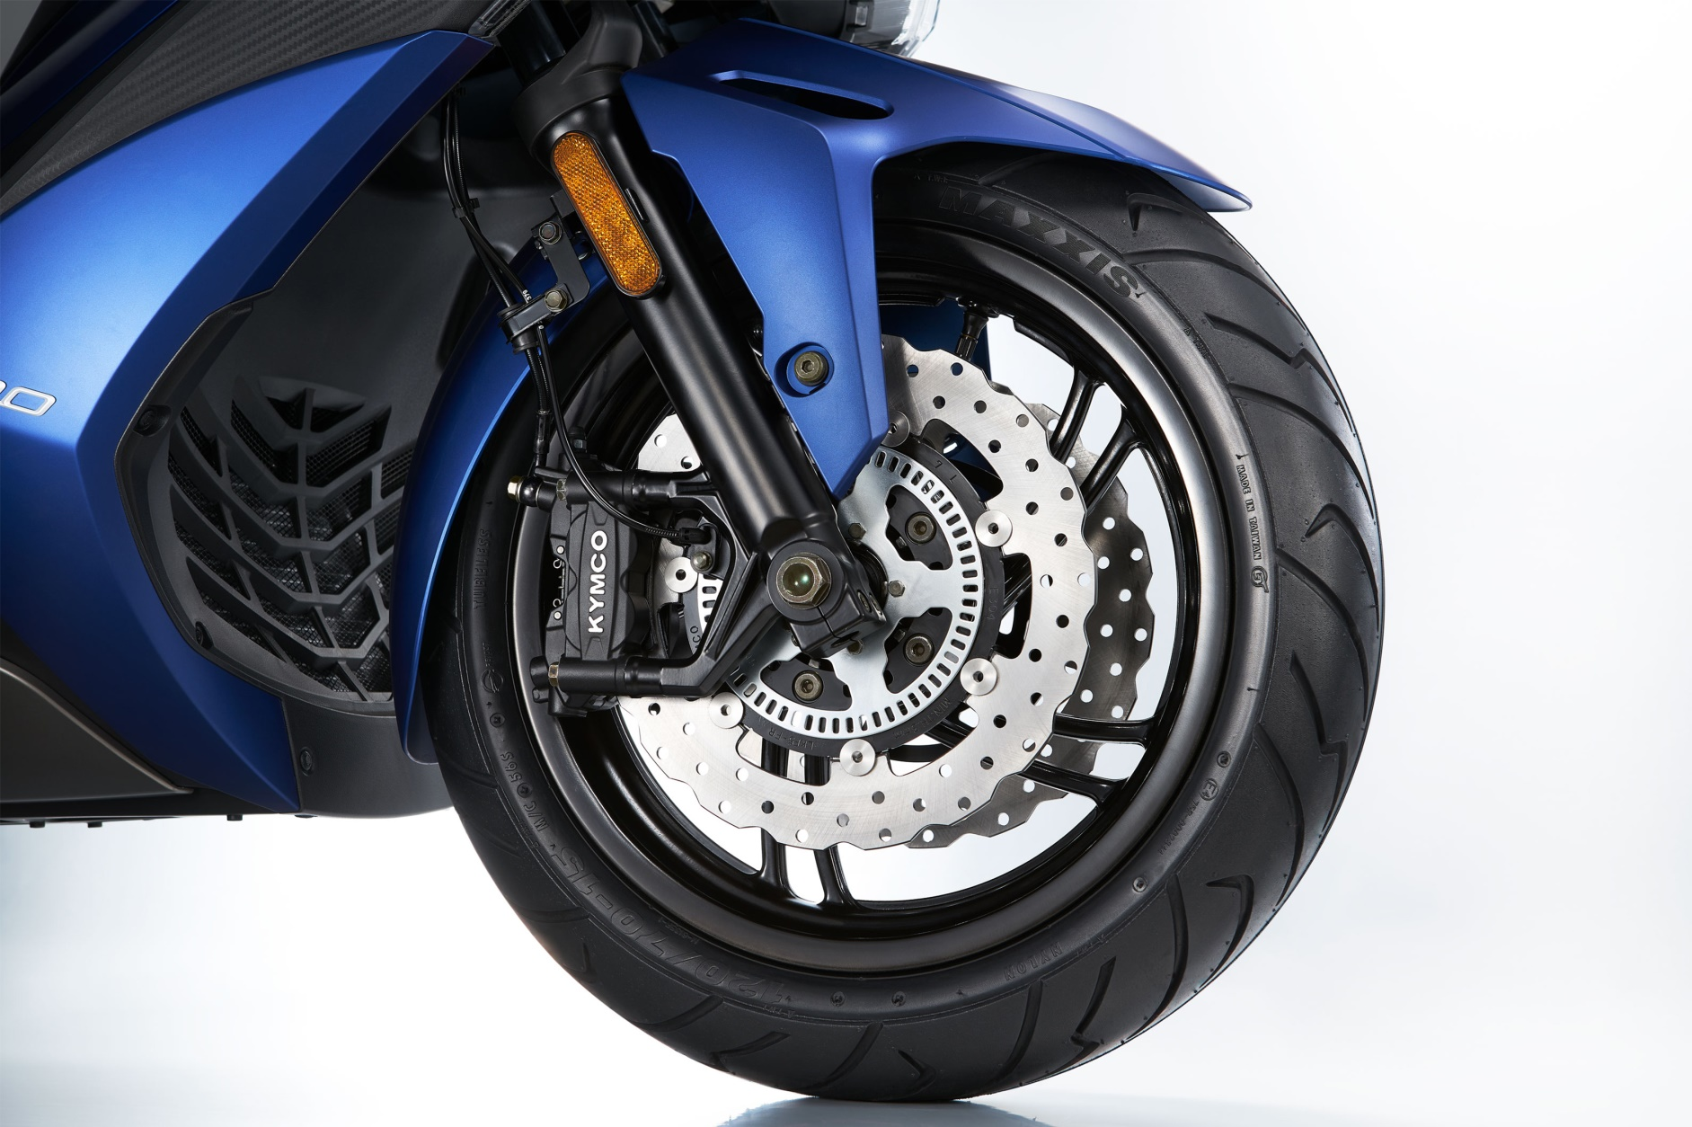
Double Disc with Bosch 9.1 ABS

Slide 6
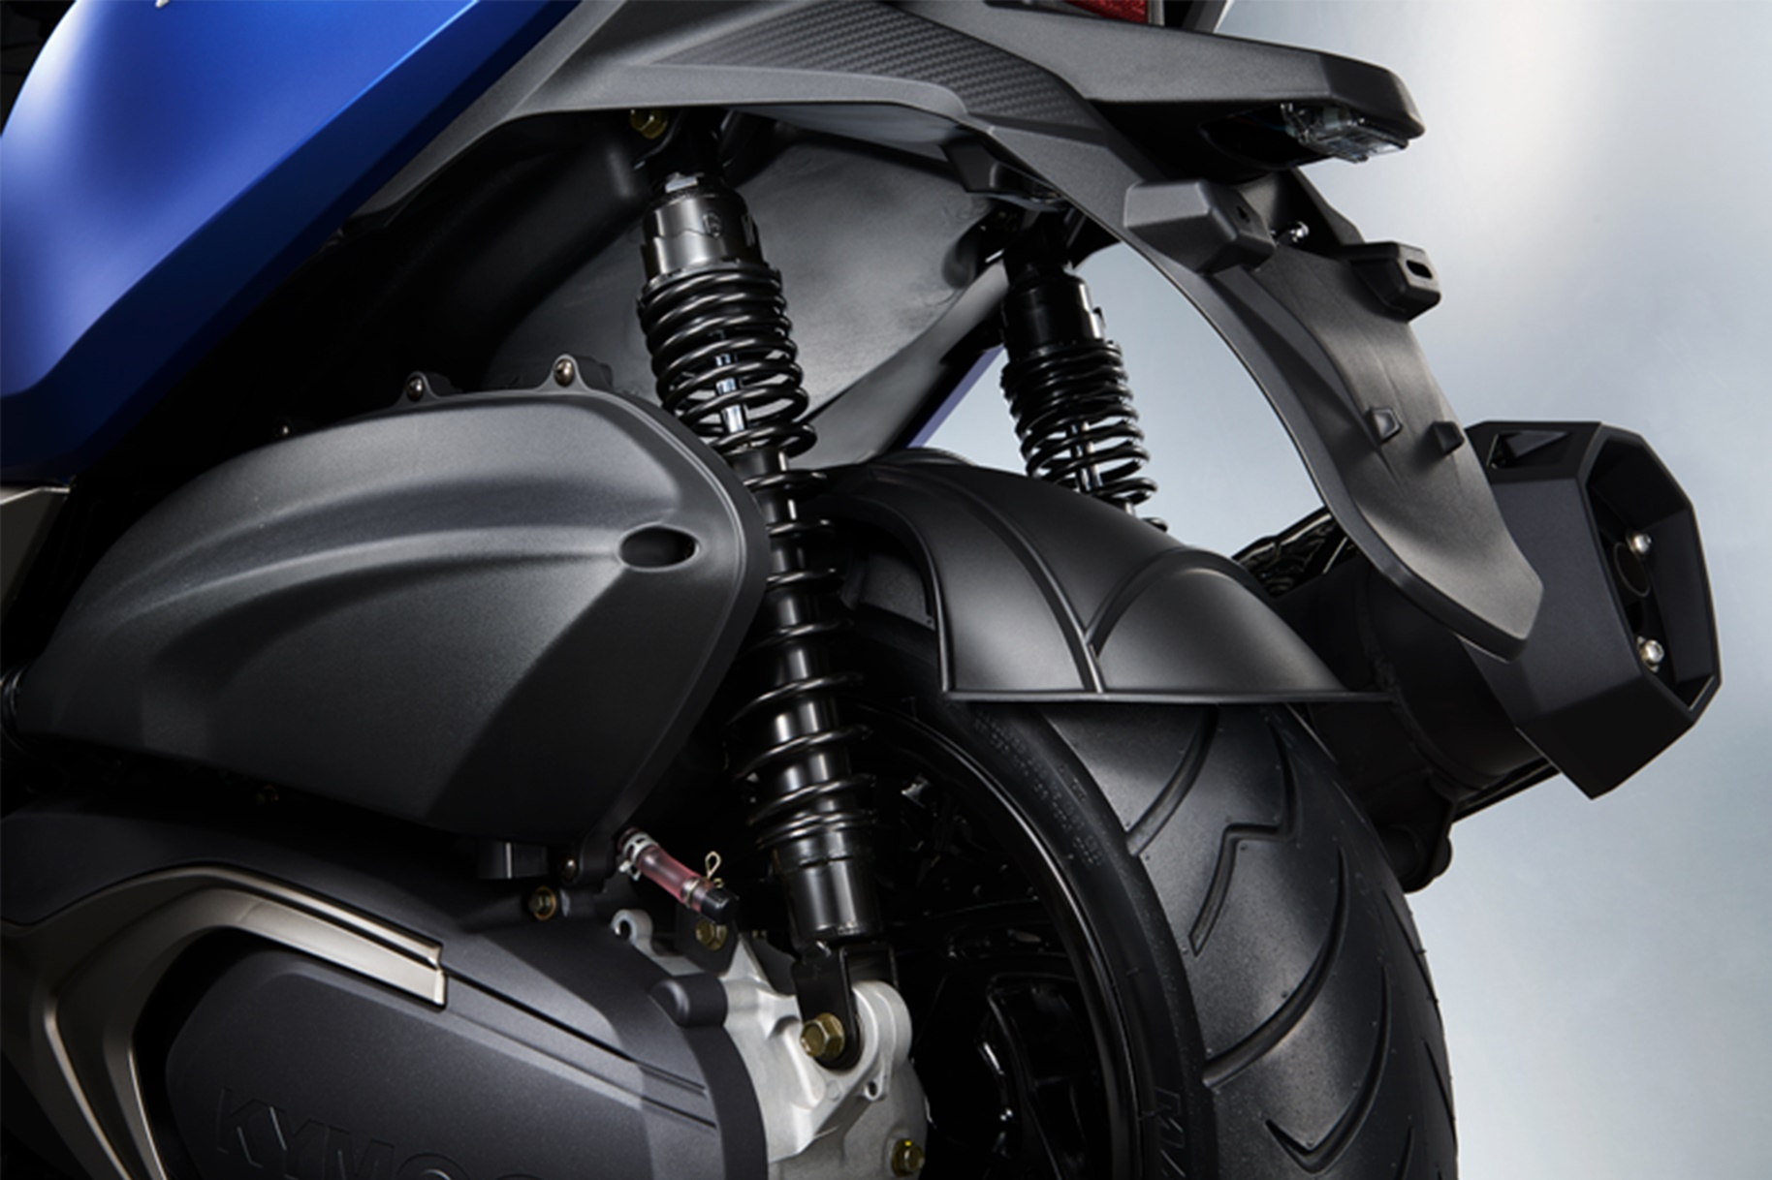
5-Step Preload Suspension

Slide 7
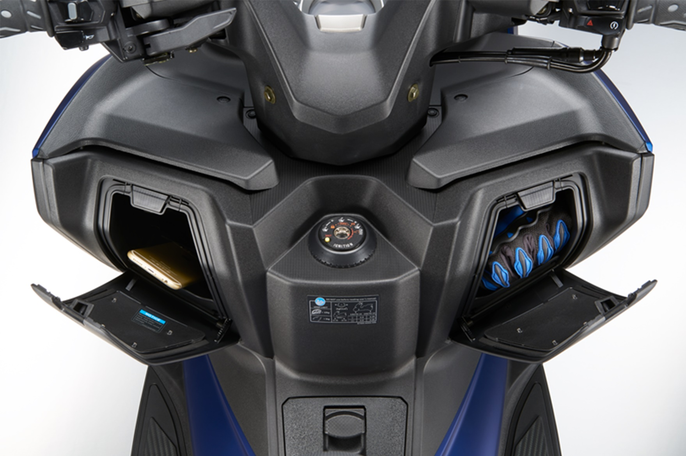
2 Glove Boxes + USB Charger

Slide 8
END OF SLIDE

